Slide 1


General Introduction to the Local GloboDiet Training Course
INTERNATIONAL AGENCY FOR RESEARCH ON CANCER LYON - FRANCE
e-SMP
Notes:
Info for the trainers: all comments for the trainers (that should be deleted or adapted for the local training course) are written in pink!!! See for example hh-mm in slide 4

Slide 2

Introduction
Training Agenda
Training objectives
Endpoints
Project objectives
General Introduction
IARC, Lyon - France
GloboDiet training:

Slide 3


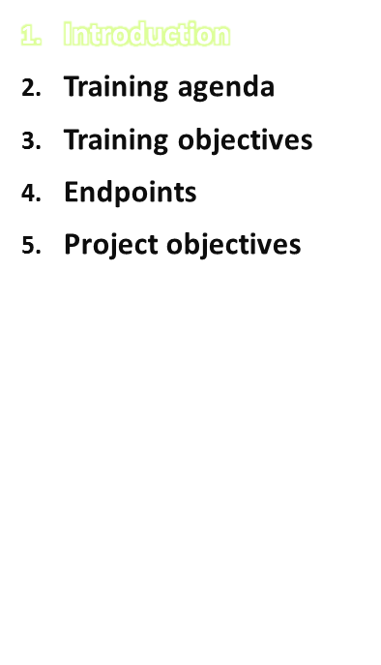
GloboDiet local training course:
To train the interviewers in charge of the local fieldwork (and those who will perform data handling)
Is organised and conducted by the local trainers who attended the “train the trainer” course at IARC
IARC provides all the necessary training materials to use the GloboDiet methodology for dietary data collection, also management and export of dietary interview data
The use of additional tools and facilities will be made available through the e-SMP in the future
The copyright for these documents is retained by IARC
General Introduction
IARC, Lyon - France
GloboDiet training:

Slide 4
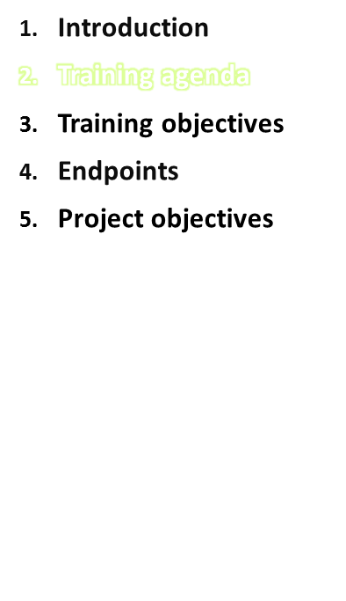
3 day training
Lunch break between hh-mm
Training contents:
  Day 1: introduction, concepts & definitions, interview examples, tips, instructions & exercises
  Day 2: Further interview instructions & exercises
  Day 3: e-SMP (interview manager) and evaluation discussion
General Introduction
IARC, Lyon - France
GloboDiet training:
Notes:
Info for the trainers: as mentioned on the first slide, all comments for the trainers (that should be deleted or adapted for the local training course) are written in pink!!! See for example hh-mm in this slide

Slide 5
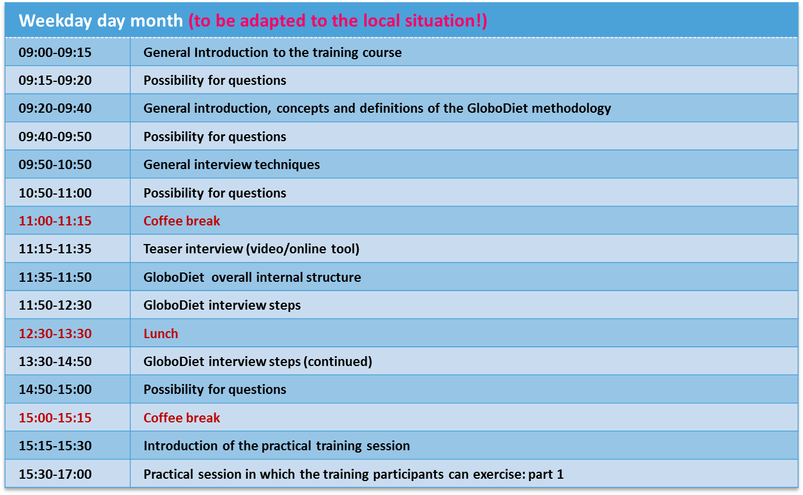
Training Agenda
General Introduction
IARC, Lyon - France
GloboDiet training:

Slide 6
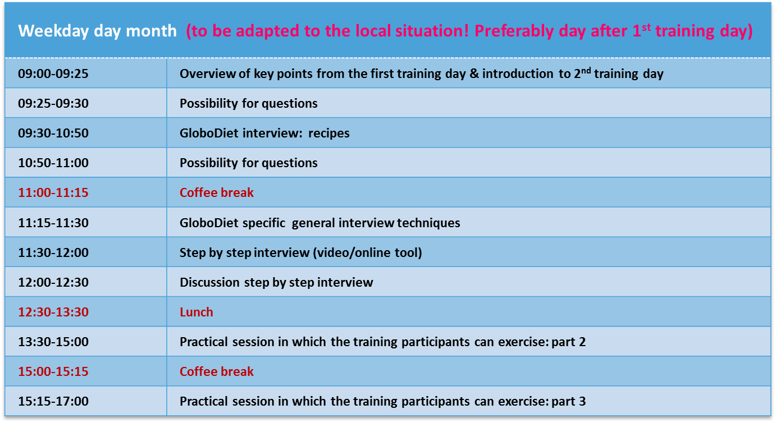
Training Agenda
General Introduction
IARC, Lyon - France
GloboDiet training:

Slide 7
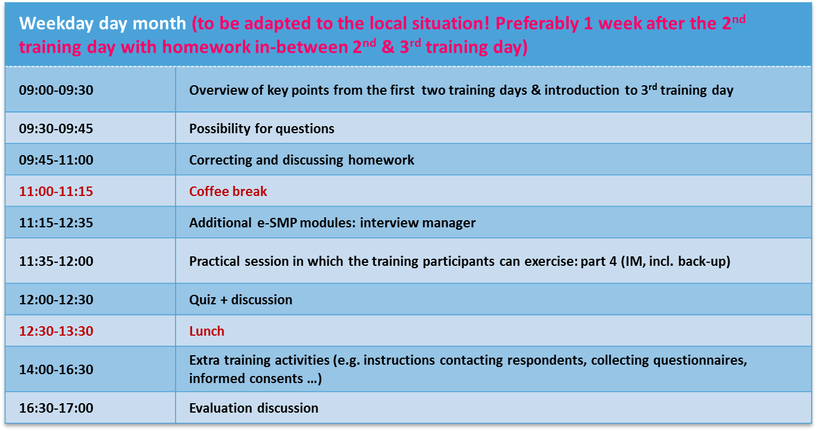
Training Agenda
General Introduction
IARC, Lyon - France
GloboDiet training:

Slide 8
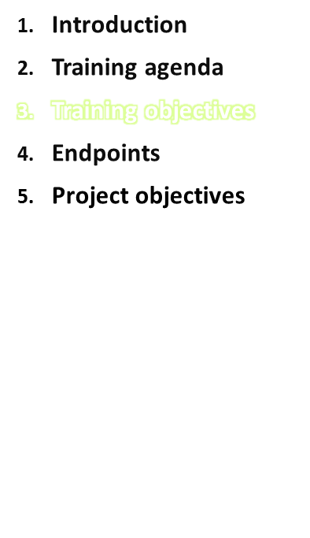
Training objectives:
To train the personnel who will perform dietary data collection fieldwork using the GloboDiet methodology thus ensuring a standardised collection and management of dietary interview data
To train those who will be in charge of handling GloboDiet dietary interview data (e.g. exporting, cleaning, etc.)
GloboDiet training:
General Introduction
IARC, Lyon - France

Slide 9
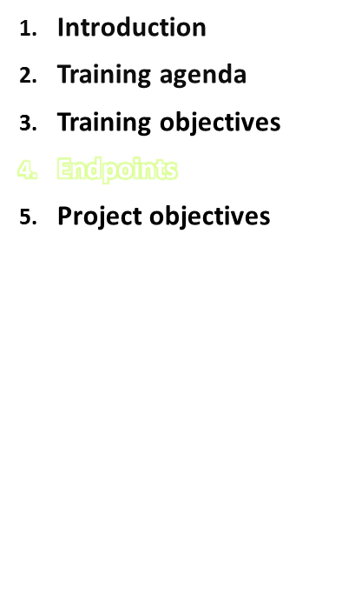
At the end of the course attendees are expected to be able to:
Use the GloboDiet application and the related management and interview tools
Perform data export and handling outside the GloboDiet application
Be aware that the interviewers will need their laptop with GloboDiet at home to exercises between the different training sessions!
GloboDiet training:
General Introduction
IARC, Lyon - France
Notes:
Be aware that the interviewers will need their laptop with EPIC-Soft at home to exercises between the different training sessions (see also presentation: Summary & Tips for Planning the Local EPIC-Soft Training)!

Slide 10
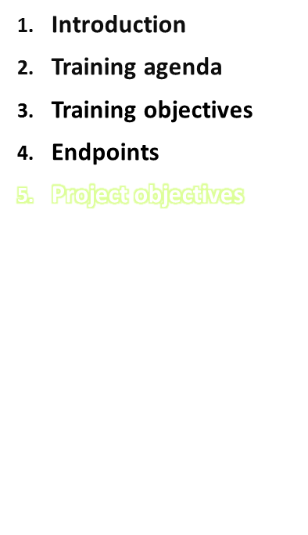
Example of objectives from PILOT study → to be adapted to your local training objectives!
PILOT-PANEU (consortium of 7 Member States (MS)) aims to contribute to the development of uniform methodologies for the estimation of dietary risks and identification of dietary habits. In 6 MS (HU, BG, FI, GR, PL, PT) the project will establish tools and methods for food intake assessment.
PILOT-PANEU will elaborate protocols and procedures for the harmonised & standardised collection of reliable individual food consumption data covering a wide age range (≥ 10-y) and will pilot test the implementation of standardised study protocols.
When concluded, the proposed project will set the infrastructure for the collection of uniform food consumption data across the MS, which is fundamental for assessing food safety hazards, emerging risks, monitoring dietary patterns, and establishing legislation to assure safe food in Europe.
GloboDiet training:
General Introduction
IARC, Lyon - France
Notes:
This slide and the following slides are project specific and should be adapted according to the project aims and objectives!!!

Slide 11
Specific project objectives
Example of objectives from PILOT study → to be adapted to your local training objectives!
To develop appropriate tools and procedures for the collection of individual food consumption data through 2 x 24-hr recalls on non-consecutive days in randomly selected populations of adolescents, adults and elderly.
Perform the dietary survey in the selected population groups
Evaluate the survey results, revise the tools & prepare recommendations for the European-wide application of the elaborated methodology.
GloboDiet training:
General Introduction
IARC, Lyon - France

